Slide 1
AtliQ Hospitality Analysis

Slide 2
Introduction
This project focuses on providing actionable insights to AtliQ Grands, a hospitality business, through a comprehensive data analysis using Power BI. By analyzing key metrics such as revenue, occupancy percentage, and booking trends, the goal is to optimize hotel performance across multiple cities and platforms. The solution leverages interactive dashboards, enabling better decision-making and enhanced customer satisfaction. This analysis empowers AtliQ Grands to identify opportunities for revenue growth and operational improvements.

Slide 3
Details of Data
The dataset consists of five key tables:
dim_date: Contains dates, week numbers, and day types (Weekend/Weekday).
dim_hotels: Includes hotel ID, name, category (Luxury, Business), and city.
dim_rooms: Describes room type and class (Standard, Elite, Premium, Presidential).
fact_aggregated_bookings: Provides hotel booking data including check-in dates, room category, successful bookings, and capacity.
fact_bookings: Detailed bookings with booking ID, guest count, platform, ratings, and revenue data.
AtliQ Hospitality Analysis

Slide 4
Main KPIs
Revenue Generated: Total revenue from hotel bookings across all properties.
Occupancy Percentage: The percentage of occupied rooms out of total available rooms, indicating hotel capacity utilization.
Average Customer Rating: Average rating given by customers for hotel services, reflecting customer satisfaction.
Booking Percentage by Platform: Percentage of bookings made through various platforms (e.g., website, app, third-party).
Successful Bookings: Number of completed bookings without cancellations, showing actual sales performance.
Trends by Week: Weekly trends for key metrics like revenue and occupancy, helping to identify peak and off-peak periods.
AtliQ Hospitality Analysis

Slide 5
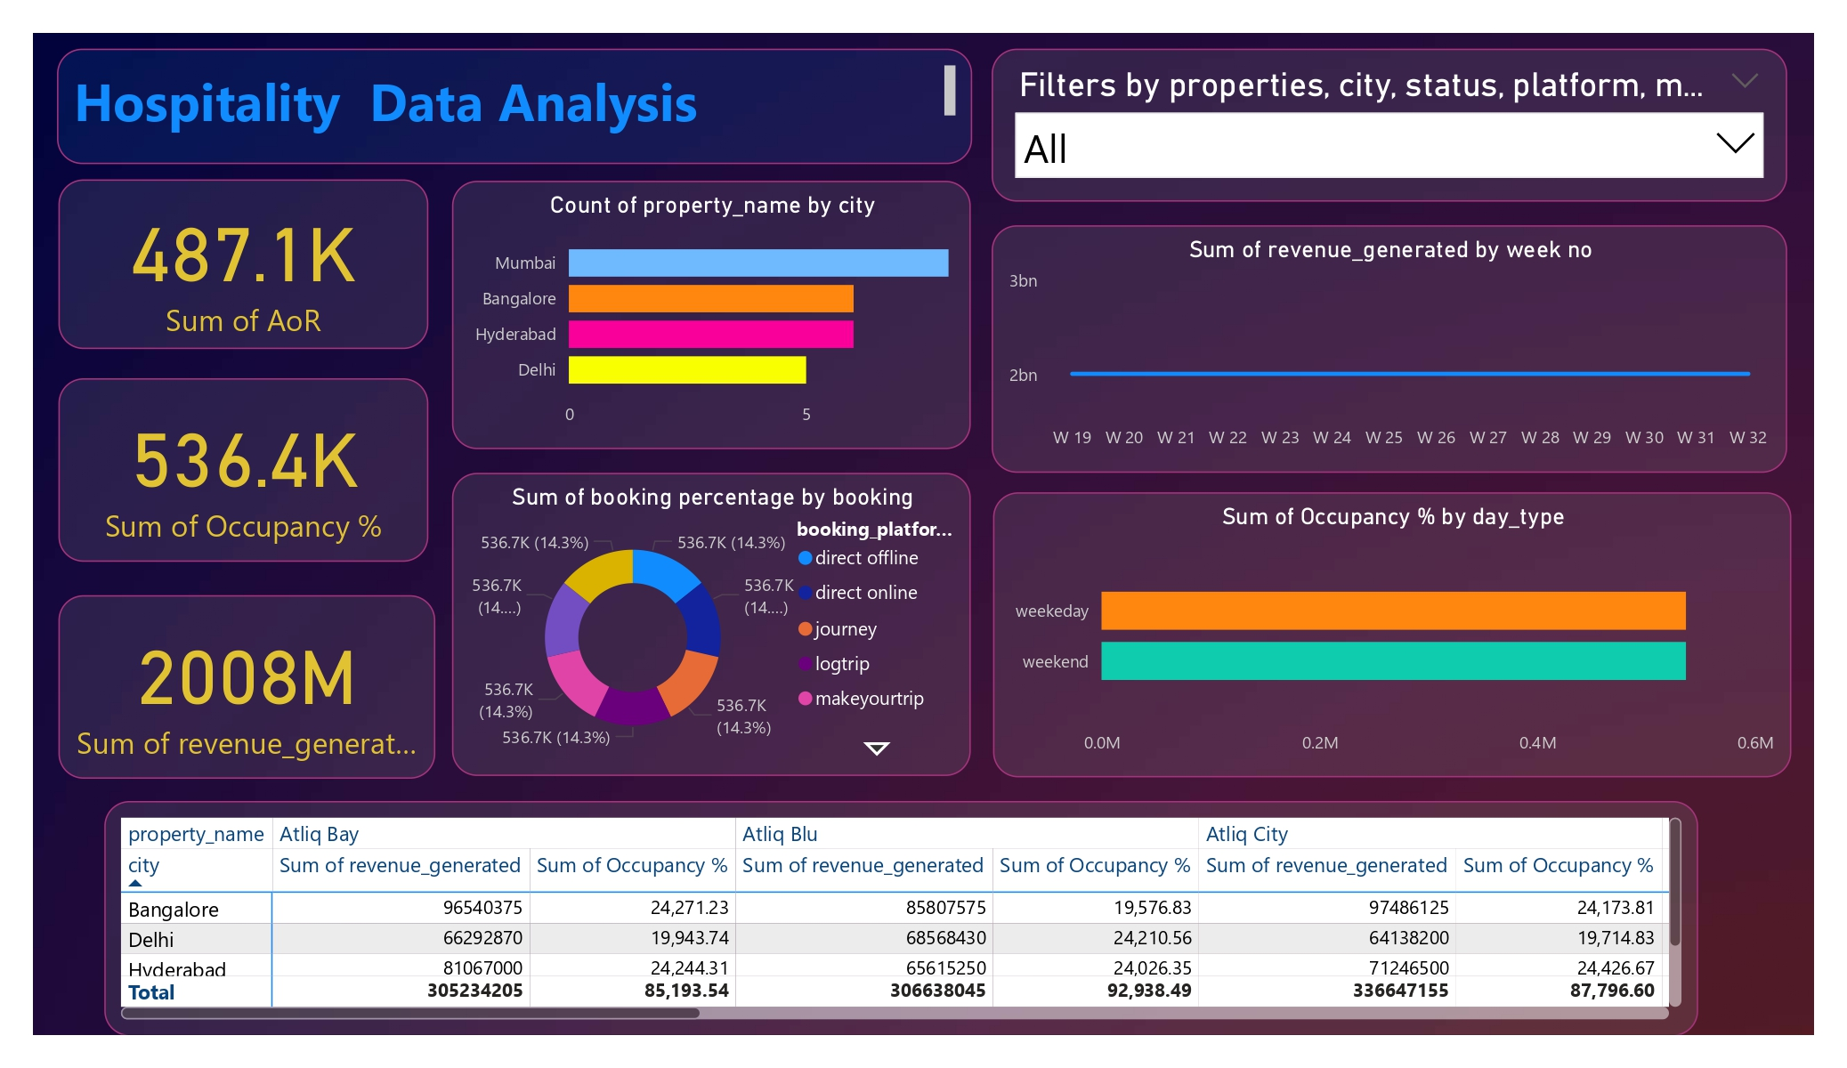
My Design
AtliQ Hospitality Analysis

Slide 6
Thank you
17/10/2024
AtliQ Hospitality Analysis

